Slide 1
Enzymes and their industrial applications
Biology for engineers
Deeya Shah
Division D
Roll no- 17
B.tech Comps
Notes:
Renin enzyme and its industrial product

Slide 2
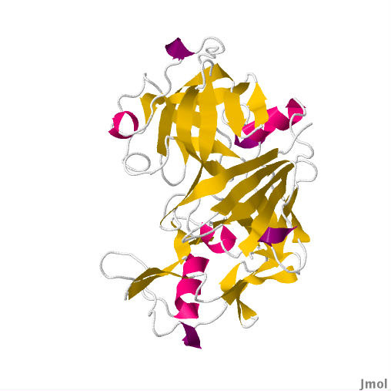
Introduction to Rennin enzyme (Chymosin)
Rennin also commonly known as Chymosin is an proteolytic enzyme found in the digestive tract of young mammal infants. It aids in the process of digestion of milk products. Rennin or Chymosin is commonly stored in the form Rennet.
It’s found in the digestive tracts of mammals such as calves, lambs, sheep, etc. its absent in the body of an adult. It’s secreted by gastric chief cells in the stomach of newborn ruminant animals.
Unethically it’s extracted from the stomach lining of young mammals such as calves, goats and such.
It can also be obtained by some microbrials, vegetation and through fermentation
It actively stops the clumping of milk by stablizing milk's Casein Micelles. It cleaves a specific Kappa-Casein. When the bond is broken it stables the Micelles resulting in solid curd. This allows the absorption of the nutrients in the milk and making the passage of milk through the infant’s body possible.
Structure of Rennin enzyme:-
Notes:
Renin enzyme and its industrial product

Slide 3
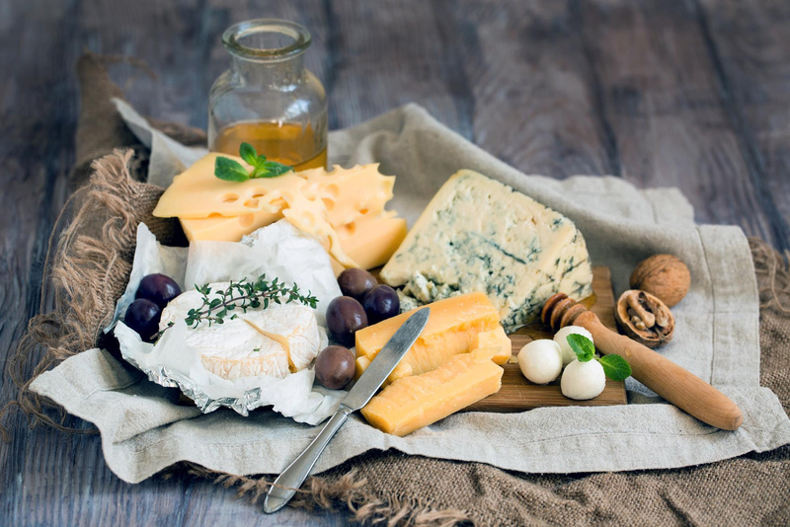
Industrial application of Rennin enzyme
Rennin enzyme is primarily used in the dairy industry. Its especially used in cheese production as it plays a key role in milk coagulation. Cheese being a semi-solid also known as curd can be achieved with Rennin.
Rennin is especially efficient as unlike other lesser specific enzymes it curds the milk without excessive breakdown of other proteins present. This affects the final product of cheese.
This is important as extensive breakdown of proteins can lead to bitterness and a poor texture in the finished cheese. The high specificity of Rennin ensures a firm, high-quality curd, which is the foundation for a good cheese.

Slide 4
Cheese making process with Rennin
Step 1:
Pasteurize the given milk and store at specific temperature between 25-30 degree Celsius and maintaining the pH at 5-6.9 for certain time for the milk clotting process. Additionally Calcium Chloride can be added to help with the formation of curd.
Step 2:
Rennin is then added in the milk in the form of Rennet. The amount added is controlled and well measured to ensure that the milk coagulation takes place within a certain timeframe. It also depends on the type of cheese that is to be formed.

Slide 5
Step 3:
After the enzyme is added to the milk the process of coagulation begins. Here the proteins of milk, known as caseins, are suspended in a colloidal state in the milk, forming structures called micelles. These micelles are stabilized by a protein on their surface called κappa-casein, which keeps the micelles from clumping together.
step 4:
The unstable casein micelles form a 3D structure which stores the proteins, minerals and fats in the milk. This coagulation process is a domino effect and forms semi-solid object called curd.
step 5:
The coagulation process is stopped once the curd has reached the desired texture. Once firm, it’s cut into call pieces for the removal of remaining liquid called whey. As whey is removed the curd stores concentrated milk fat and casein. It’s further processed to refine it.

Slide 6
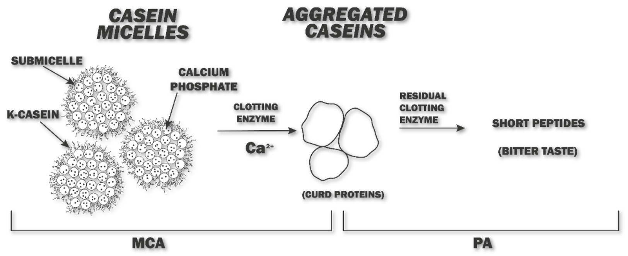
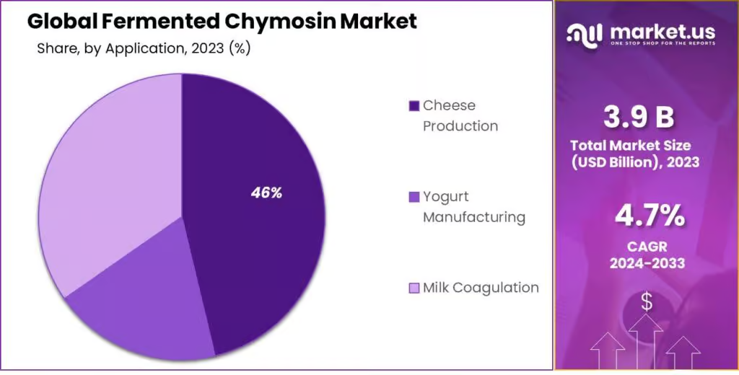

Slide 7
How to incorporate Rennin as an engineer
Fermentation process is a process where Rennin(FPC) is produced. It takes place in huge bioreactors and controlling things such as the precise pH, temperature, time, amount manually is hard labor.
A computer engineer can develop the real-time control systems that monitors and adjusts crucial parameters like temperature, pH, and nutrient levels to ensure the microorganisms are producing the enzyme as efficiently as possible. This involves writing software that interfaces with sensors and actuators, and using feedback loops to maintain optimal conditions.

Slide 8
References:-
Information:-
https://www.wisconsincheese.com/the-cheese-life/article/227/how-is-cheese-made-a-comprehensive-guide
https://en.wikipedia.org/wiki/Chymosin
https://www.sciencedirect.com/topics/neuroscience/chymosin
https://vivo.colostate.edu/hbooks/pathphys/digestion/stomach/rennin.html
https://www.researchgate.net/figure/Milk-clotting-activity-of-chymosin-at-different-values-of-temperature-and-pH-The_fig3_305110369
Images:-
https://www.chemistryworld.com/podcasts/chymosin/3007682.articlef
https://www.mdpi.com/2304-8158/11/6/871
https://market.us/report/fermented-chymosin-market/
Thank you.

